Slide 1

Capstone Project
Airbnb Booking Analysis
By Mayank Sawant

Slide 2
Points for Discussion
Introduction
Problem Statement
Dataset Summary
Hosts with most Listings
Listings in each neighbourhood group
Wordcloud of Neighbourhoods
Top 5 Hottest Areas by percentage
Reviews as per Neighbourhood groups
Price Distribution by Neighbourhood Groups
Busiest Hosts
Room Type Distribution and their Coordinates
Neighbourhood Group Distribution Coordinates
Conclusion

Slide 3
Introduction
Airbnb is an online marketplace that connects people who want to rent out their homes with people who are looking for accommodations in specific locales.
The company has come a long way since 2008, when its co-founders first came up with the idea to invite paying guests to sleep on an air mattress in their living room.

Slide 4
Problem Statement
Today, Airbnb became one of a kind service that is used and recognized by the whole world. Data analysis on millions of listings provided through Airbnb is a crucial factor for the company.
These millions of listings generate a lot of data - data that can be analyzed and used for security, business decisions, understanding of customers' and providers' (hosts) behavior and performance on the platform, guiding marketing initiatives, implementation of innovative additional services and much more.

Slide 5
Dataset Summary
Our dataset is feature rich containing, location with co-ordinates, prices, host name, room types, availability throughout season.
price 11. room_type
name 12. minimum_nights
host_id 13. number_of_reviews
latitude 14. reviews_per_month
longitude 15. last_review
neighbourhood 16. host_name
neighbourhood_group
calculated_host_listing_count
id
availability_365

Slide 6
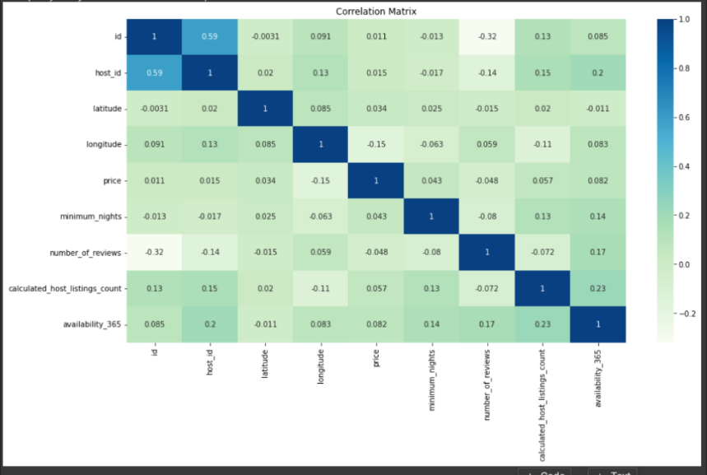
Correlation Matrix
Here we can see, independent features are very less correlated to our dependent feature 'Price'.

Slide 7
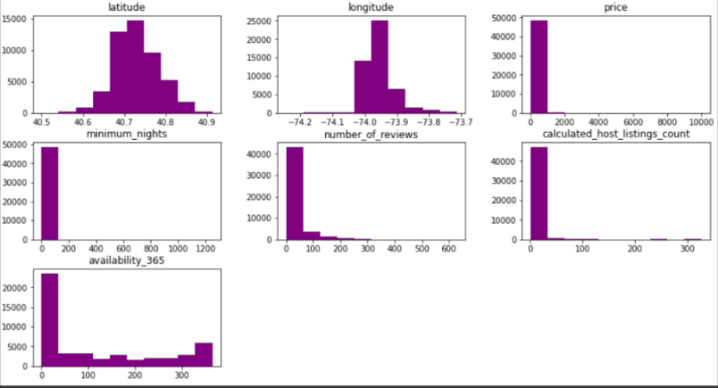
Distribution of Data
We have plotted the data distribution plots for the numerical features present in the dataset. The distribution shows that most of the features are positively skewed.

Slide 8
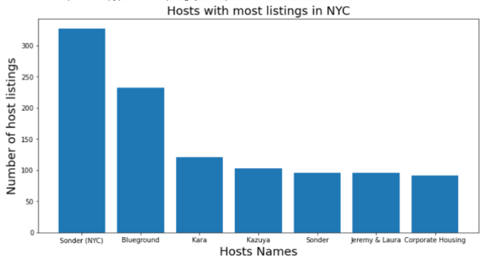
Hosts With Most Listings
Sonder(NYC) is the host with most listings with 327 listings.

Slide 9
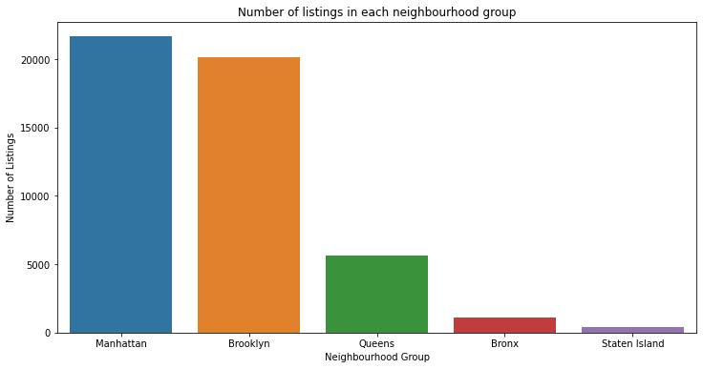
Listings in each neighbourhood group
Around 85% of listings are held in neighbourhood groups Manhattan and Brooklyn.

Slide 10
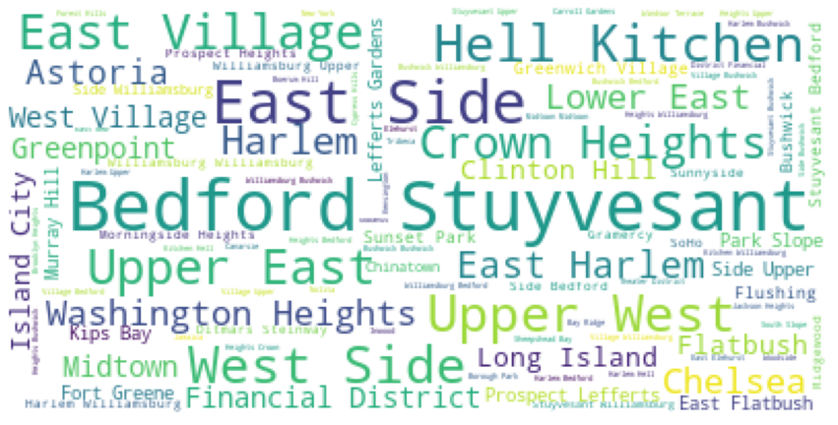
Wordcloud of Neighbourhoods
In terms of listings, Bedford Stuyvesant, Hell Kitchen, East Side are the most important neighbourhoods in NYC.

Slide 11
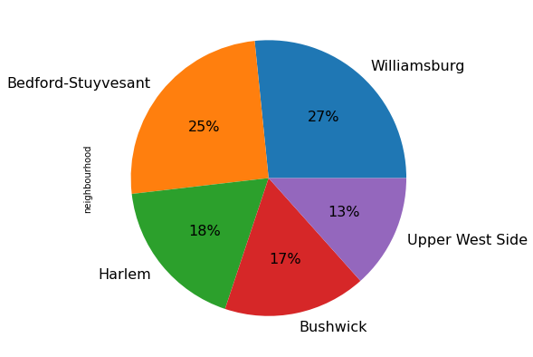
Top 5 Hottest Areas by Percentage
Bedford Stuyvesant and Williamsbury are the two dominating transaction areas.

Slide 12
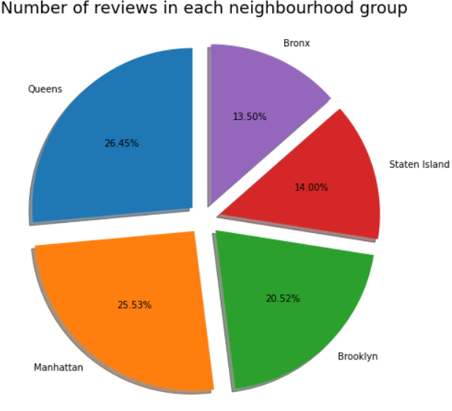
Reviews As Per Neighbourhood Group
Most of the reviews are from Manhattan and Queens. Bronx and Staten Island share almost same amount of reviews.

Slide 13
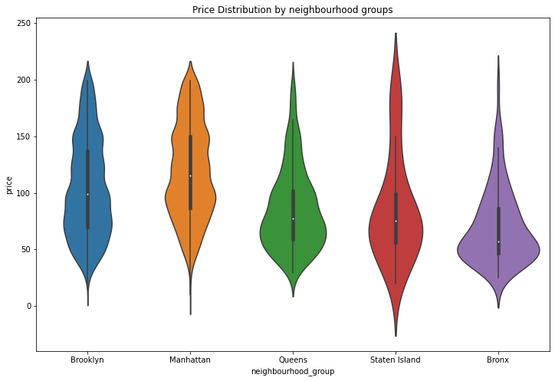
Price Distribution By Neighbourhood Groups
Manhattan has higher price range and is the expensive one. Brooklyn has the second highest rental prices, while Bronx appears as the most affordable one.

Slide 14
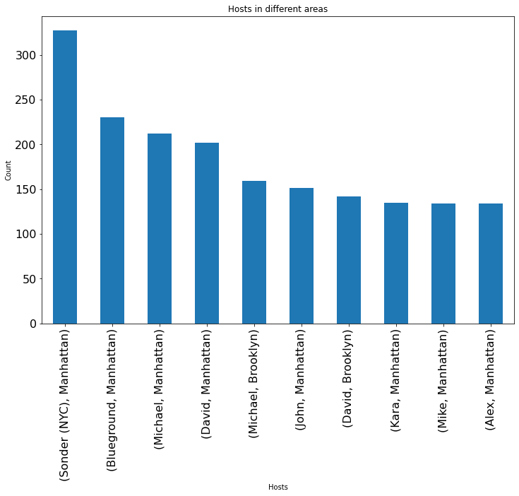
Busiest Hosts
Here are the top 10 busiest hosts in NYC. Sonder(NYC) from Manhattan is the busiest host and also most of the hosts are from Manhattan neighbourhood group.

Slide 15
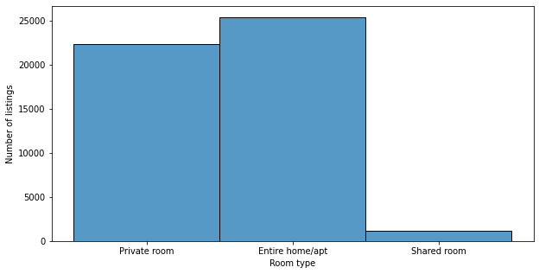
Room Type Distribution
People mostly prefer to rent Private room or Entire home/apt. Very few people are considering to a share a room.

Slide 16
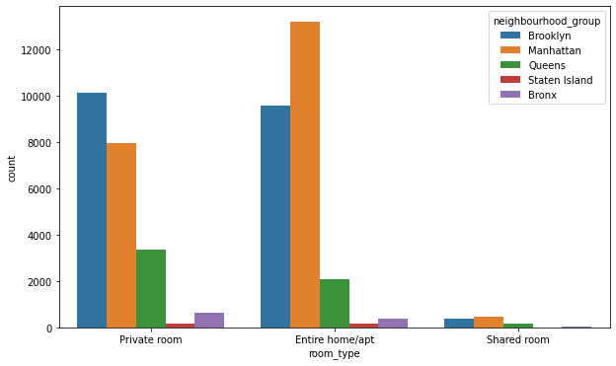
Room Type Distribution As Per Neighbourhood Group
In Manhattan, people prefer to stay mostly in entire home. In Brooklyn, guests prefer private rooms more than entire home.

Slide 17
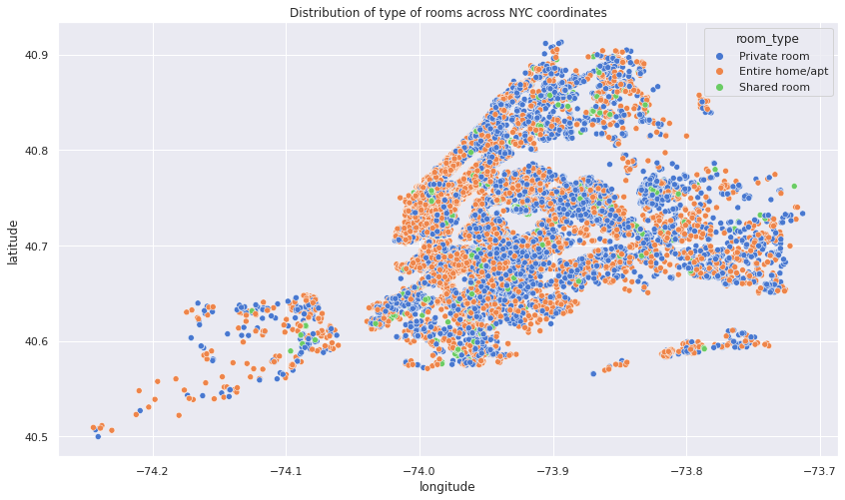
Room Type Distribution Location Coordinates
Above scatterplot shows that entire home and private room listings are very dense. There are very few shared room listings as per the location coordinates.

Slide 18
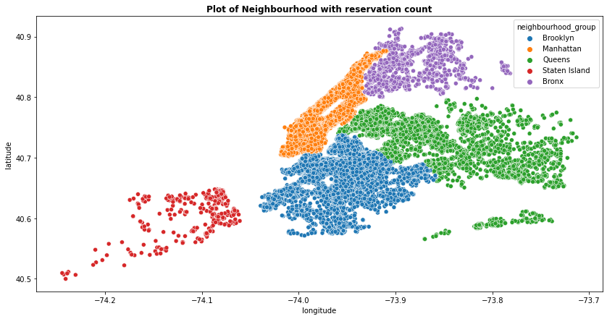
Neighbourhood Group Location Coordinates
Manhattan and Brooklyn are high density neighbourhood groups with respect to listings. Some areas of Staten Island and Bronx are very remotely located which makes them cheaper than other listings.

Slide 19
Conclusion
Sonder is the busiest host in New York.
Entire home are costly than other room types
Most visitors don’t prefer shared rooms, they tend to visit private room or entire home.
Manhattan has the highest number of listings.
Bronx has most number of cheap rooms.
Queens have more reviews than Manhattan even though Queens has less listings.

Slide 20
Thank You

